Slide 1

Zerelö
VEHICLE SERVICES...

Slide 2

Zerelö
Vehicle Breakdown Service
This presentation outlines the development of a comprehensive vehicle breakdown system, designed to enhance roadside assistance and streamline the process of handling vehicle breakdowns. The project will aim to provide a user-friendly platform for both drivers and service providers.

Slide 3
Understanding the Problem: Defining the Business Case
Current Challenges
Business Case
Inefficient communication, delayed assistance, lack of real-time data, and inconsistent service quality are common challenges faced by roadside assistance providers.
A new system will address these challenges, improve customer satisfaction, and enhance operational efficiency, creating a positive impact on the company's bottom line.

Slide 4

Crafting the Problem Statement: Key Elements and Considerations
1
1. Inefficient Communication
2
2. Lack of Real-Time Data
Current communication channels are often slow and unreliable, leading to delays in assistance.
Limited access to real-time data hinders service providers' ability to make informed decisions and optimize routes.
3
3. Inconsistent Service Quality
Varying service quality can lead to customer dissatisfaction and negatively impact the company's reputation.

Slide 5

Stakeholder Analysis: Identifying Key Stakeholders and Their Needs
Drivers
Service Providers
Management
Seek prompt, reliable, and transparent roadside assistance.
Require efficient routing, real-time data access, and seamless communication.
Demand improved operational efficiency, reduced costs, and enhanced customer satisfaction.

Slide 6
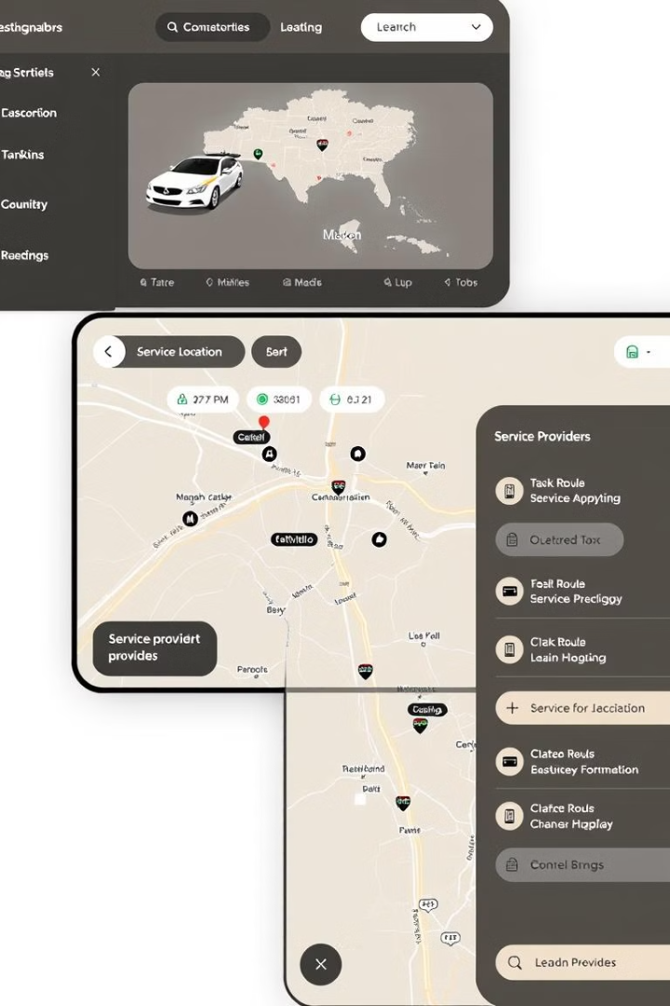



Proposed Solution: Aligning with Business Objectives
Real-Time Tracking
Two-Way Communication
Monitor vehicle locations, service provider routes, and ETA for improved efficiency.
Enable direct communication between drivers, service providers, and customer support.
Data Analytics
Generate reports and insights to optimize operations, improve service quality, and identify trends.

Slide 7
USER STORIES
User Story 1: User
As a Vehicle Owner,
I want Request Service for a vehicle for a vehicle and a break down service quickly via mobile app,
so that I can get help in case of an emergency without delay.
Acceptance Criteria :
I can enter my location and issue details in the app
I receive confirmation of my request and an estimated arrival time of the service provider
I am notified when the service provider in enroute.

Slide 8
User Story 2: Service provider
As a Breakdown service technician,
I want Receive detailed into about the breakdown request on my device,
so that I can prepare the necessary tools & reach the location efficiently
Acceptance Criteria:
Alert Reception:
The service provider receives an immediate notification on their mobile/desktop when a vehicle breakdown occurs in their assigned area.
Notification contains the vehicle’s location, breakdown details, and the user’s contact information.
Task Acceptance:
Service provider can accept or decline the assistance request.
If declined, a notification is sent to the user, and the system will automatically find the next available service provider.
Upon acceptance, the system will display the estimated arrival time (ETA).
Journey Tracking:
The service provider can view navigation instructions to the breakdown location via integrated maps or GPS.
The service provider can update the user with an ETA in case of delays.

Slide 9
User Story 3: Administrator
Title: Admin Management of Service Providers and User Requests
As an Administrator, I want to manage service provider assignments and oversee real-time vehicle breakdown requests, so that I can ensure smooth operations and a high quality of service. Acceptance Criteria:
User Request Monitoring:
The admin can view all incoming user requests in real-time on a dashboard.
The admin can filter and sort requests by area, priority, or status (e.g., awaiting assistance, in progress, completed).
Assigning Service Providers:
The admin can manually assign a service provider to a user request if no provider accepts automatically.
The admin can view the current location and status of service providers, and if needed, reassign providers to optimize coverage.
Service Provider Performance Tracking:
The admin can monitor the performance of service providers (e.g., response time, number of resolved requests, customer ratings).

Slide 10
Product Vision Document
1. Audience
Primary Audience:
Vehicle owners who want to track and manage their vehicle maintenance efficiently.
Individuals looking for timely reminders for servicing, insurance renewal, and repairs.
Fleet managers who need an organized system for maintaining multiple vehicles.
Secondary Audience:
Automobile service centers looking for a digital platform to manage appointments and customer records.
Roadside assistance providers who want an efficient way to connect with users needing emergency help. 2. Needs
Primary Needs:
A streamlined system for booking, tracking, and managing vehicle services.
Real-time service reminders based on mileage, usage, and time intervals.
Secure storage and easy access to vehicle-related documents (insurance, registration, service records).
AI-driven issue detection and maintenance recommendations.
Secondary Needs:
Integration with OBD (On-Board Diagnostics) devices or vehicle sensors for automated status updates.
Cost analysis and tracking of service expenses.
AI-based predictions of future maintenance costs.
Roadside assistance request system for emergencies.

Slide 11
Product Vision Document
3. Product
Core Product:
A mobile and web-based vehicle service management system that helps users book services, track maintenance history, receive AI-driven recommendations, and manage vehicle expenses efficiently.
Additional Features:
Smart Service Reminders: Automated notifications for servicing, insurance renewals, and inspections.
AI-Based Issue Detection: Analyzes vehicle data and service history to predict potential maintenance needs.
Expense Tracking & Analysis: Allows users to monitor spending on maintenance, repairs, and fuel.
Service Center Recommendations: Suggests nearby service providers based on ratings and availability. 4. Values
Core Values:
Convenience: Simplifying vehicle maintenance with automated tracking and smart notifications.
Reliability: Providing users with accurate service records and AI-driven insights.
Cost Efficiency: Helping users optimize service expenses and avoid unnecessary repairs.
Differentiators:
Comprehensive Expense Tracking: Integrates cost analysis with smart budgeting for vehicle-related expenses.
Emergency Support Integration: Connects users with roadside assistance providers for immediate help.

Slide 12
PRODUCT BACKLOG REFINEMENT
ID | Feature Name | Category | User Story | Priority | Status | Acceptance Criteria | Dependencies | Performance Requirements | Estimated Effort | Estimated Completion
1 | User Authentication & Registration | Authentication | As a user, I want to securely log in and register using my email or phone number. | Must | In Progress | 1. The user can register with a valid email and password. 2. Secure authentication implemented. | Secure password hashing and authentication. User session management. | Response time for authentication should be < 2 seconds. | 5 days | 4 days
2 | Real-time Breakdown Assistance Request | Breakdown Services | As a driver, I want to request breakdown assistance and track the service provider in real time. | Must | Pending | 1. User can send a breakdown request with location. 2. Service provider can accept and track the request. | Live GPS tracking and request management system. | Breakdown request processing should be under 5 seconds. | 7 days | 6 days
3 | Vehicle Service Scheduling | Car Service | As a car owner, I want to schedule periodic maintenance and repairs at authorized service centers. | Should | Backlog | 1. Users can select a service and available time slot. 2. Booking confirmation is sent to the user. | Service provider availability and scheduling system. | Service scheduling should be user-friendly and responsive. | 6 days | 5 days
4 | Live Mechanic Tracking | Service Tracking | As a user, I want to see the location of my assigned mechanic on a map in real time. | Must | Ready for Dev | 1. Assigned mechanic’s live location is displayed to the user. 2. Estimated arrival time is shown. | Real-time tracking API integration. | Live tracking should refresh every 5 seconds. | 7 days | 6 days

Slide 13
PRODUCT BACKLOG REFINEMENT
ID | Feature Name | Category | User Story | Priority | Status | Acceptance Criteria | Dependencies | Performance Requirements | Estimated Effort | Estimated Completion
5 | Emergency Towing Service | Roadside Assistance | As a stranded driver, I want to request a tow truck to take my vehicle to the nearest service station. | Must | In Progress | 1. Users can request towing by providing their location. 2. The nearest towing service is assigned. | Towing service dispatch and tracking system. | Towing request response time should be within 2 minutes. | 5 days | 4 days
6 | User Reviews & Ratings for Mechanics | User Feedback | As a user, I want to rate and review mechanics and service centers based on my experience. | Could | Pending | 1. Users can submit reviews and ratings after a service. 2. Average ratings are displayed for mechanics. | Review and rating system for service providers. | Review submission should be processed within 3 seconds. | 4 days | 3 days
7 | Service Cost Estimation | Cost Estimation | As a car owner, I want to receive an estimated cost for repairs and services before booking. | Should | Backlog | 1. Users receive an estimated cost before confirming service. 2. Breakdown of charges is provided. | Cost estimation engine based on service type and vehicle model. | Cost estimates should be generated instantly. | 6 days | 5 days
8 | Multi-Vehicle Management | Vehicle Management | As a car owner, I want to manage multiple vehicles under one account to easily schedule services for each. | Should | Backlog | 1. Users can add, edit, and remove multiple vehicles. 2. Each vehicle has its own service history and scheduling options. | Vehicle data storage and user profile management. | System should allow seamless switching between vehicles. | 5 days | 4 days

Slide 14
PRODUCT BACKLOG REFINEMENT
ID | Feature Name | Category | User Story | Priority | Status | Acceptance Criteria | Dependencies | Performance Requirements | Estimated Effort | Estimated Completion
9 | Push Notifications for Service Updates | Notifications | As a user, I want to receive real-time push notifications for service updates, reminders, and promotions. | Should | Pending | 1. Users receive notifications for booking confirmations, service status, and mechanic arrival. 2. Users can enable or disable notifications from settings. | Notification system and user preferences management. | Notifications should be delivered within 2 seconds. | 4 days | 3 days
10 | AI-Based Issue Diagnosis | Diagnostics | As a car owner, I want an AI-powered tool to help diagnose basic vehicle issues based on symptoms I enter. | Could | Backlog | 1. Users can enter symptoms like strange noises or performance issues. 2. AI provides probable causes and suggests next steps. | AI-powered symptom analysis engine. | Diagnosis should be provided within 5 seconds. | 7 days | 6 days
11 | Roadside Battery Jumpstart Request | Roadside Assistance | As a stranded driver, I want to request a battery jumpstart service if my vehicle won’t start. | Must | Ready for Dev | 1. Users can request battery jumpstart assistance and share their location. 2. The nearest available service provider is assigned. | Service dispatch system and GPS tracking. | Response time should be within 3 minutes. | 5 days | 4 days

Slide 15
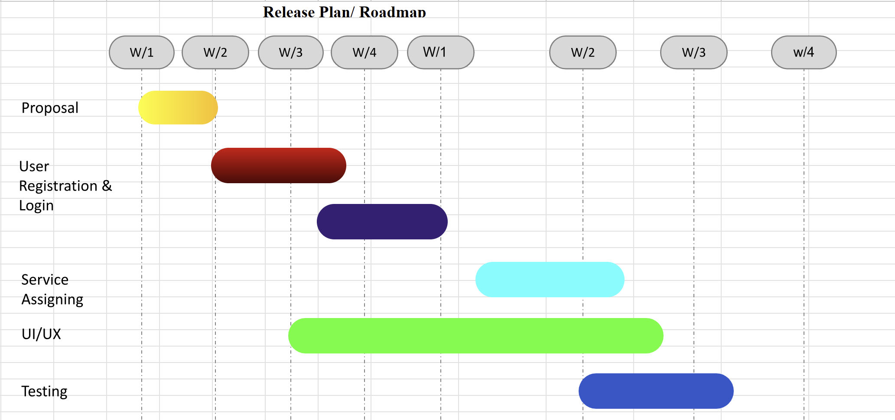
Release Plan – GANTT Chart

Slide 16
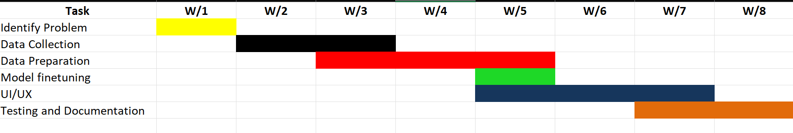
Updated Gantt Chart

Slide 17
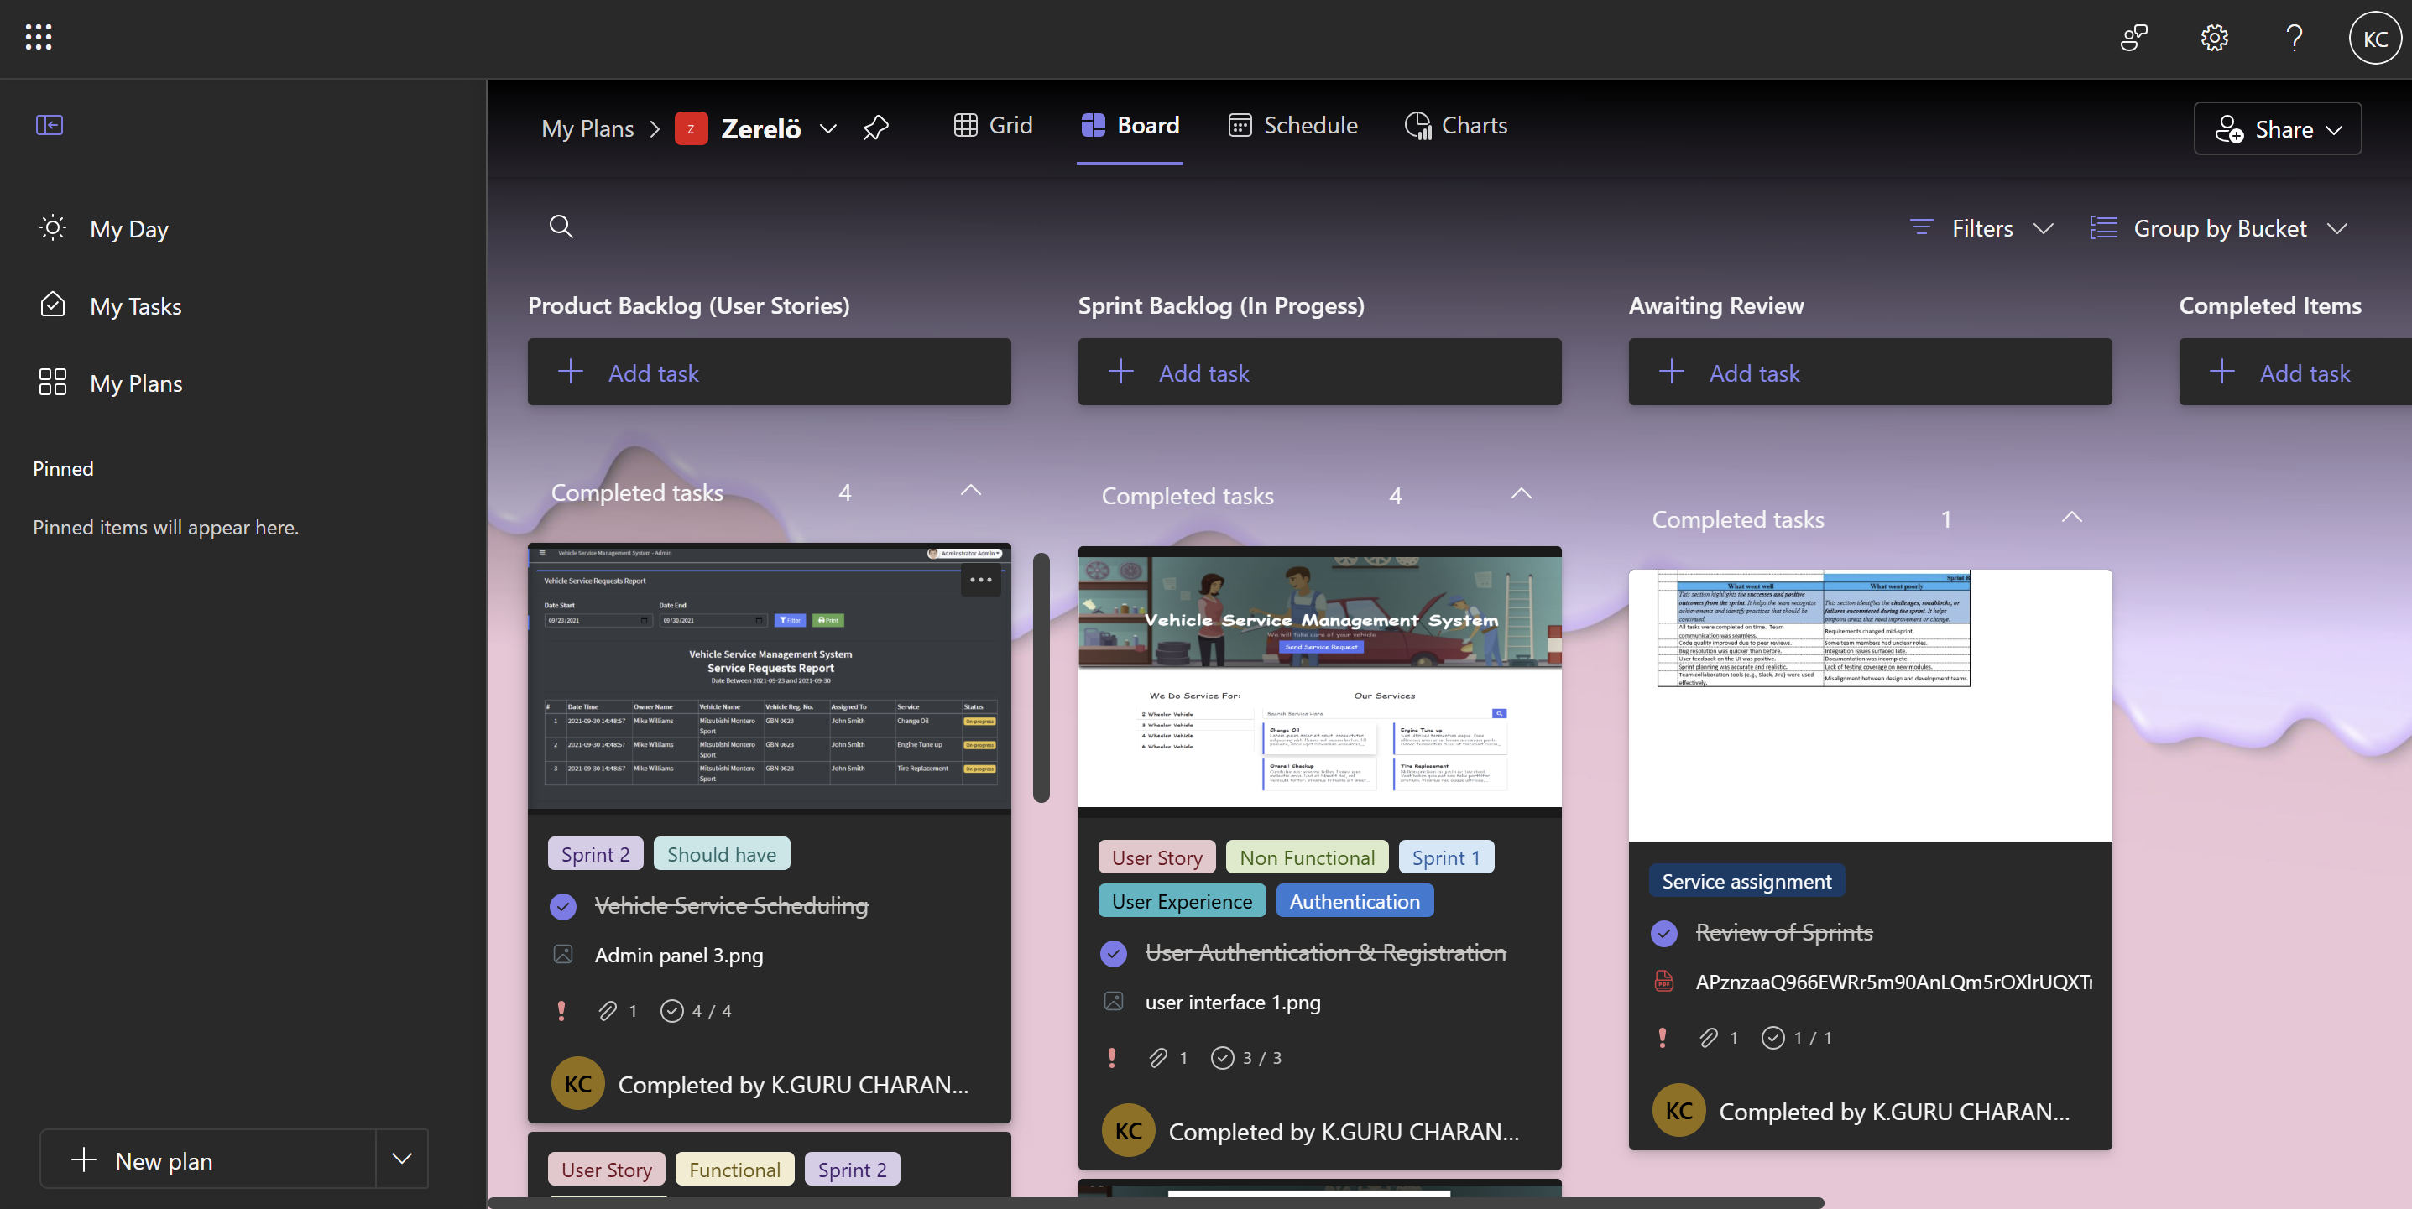
MICROSOFT PLANNER

Slide 18
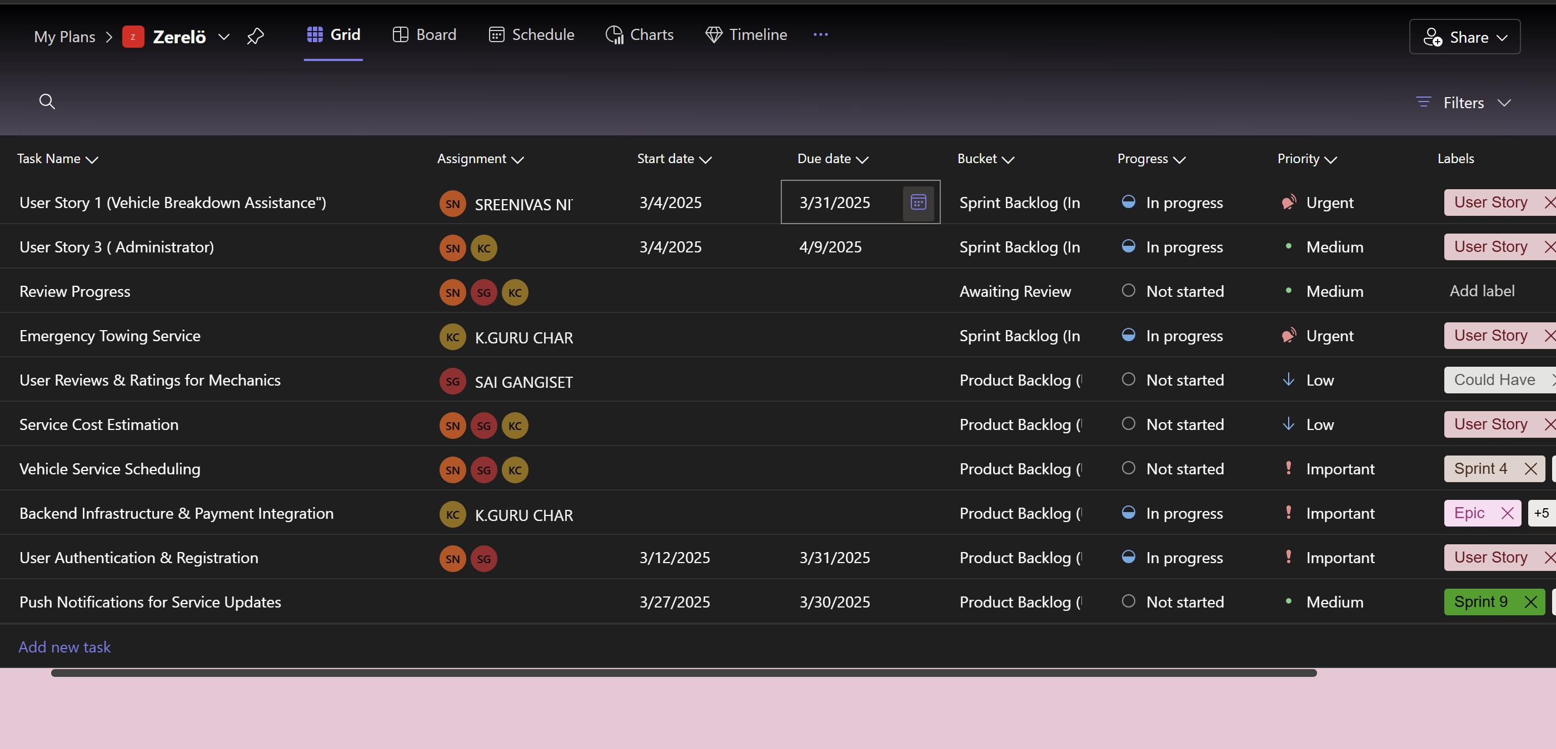
MICROSOFT PLANNER

Slide 19

Architecture Diagrams

Slide 20
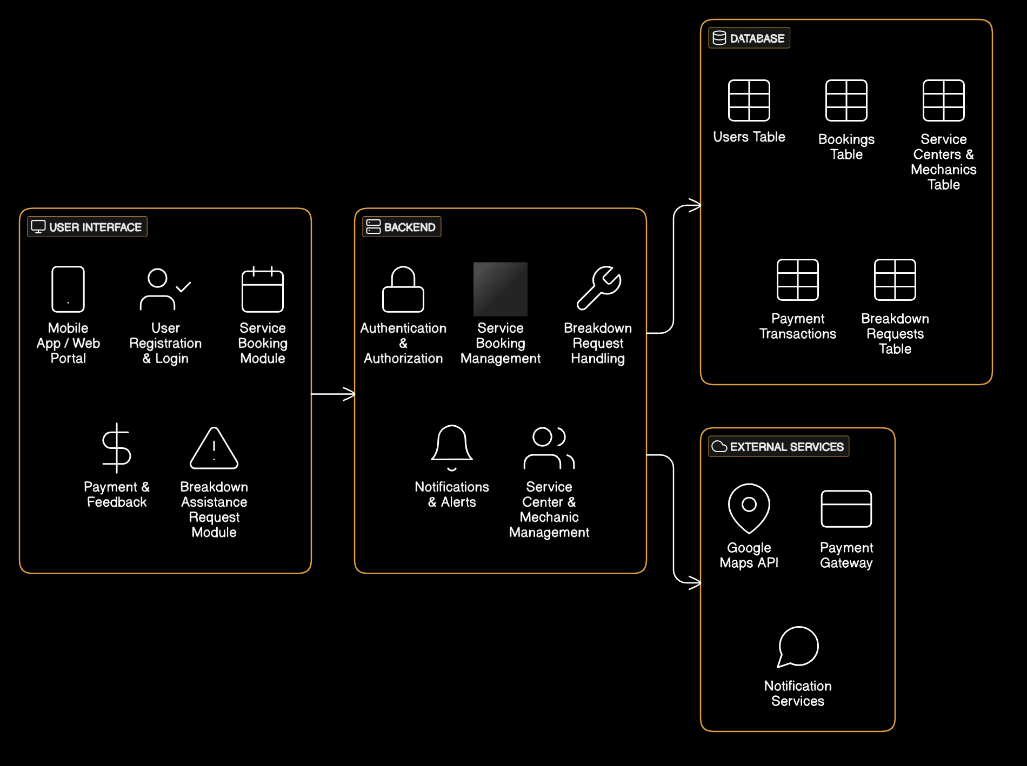
ARCHITECTURE DIAGRAM

Slide 21
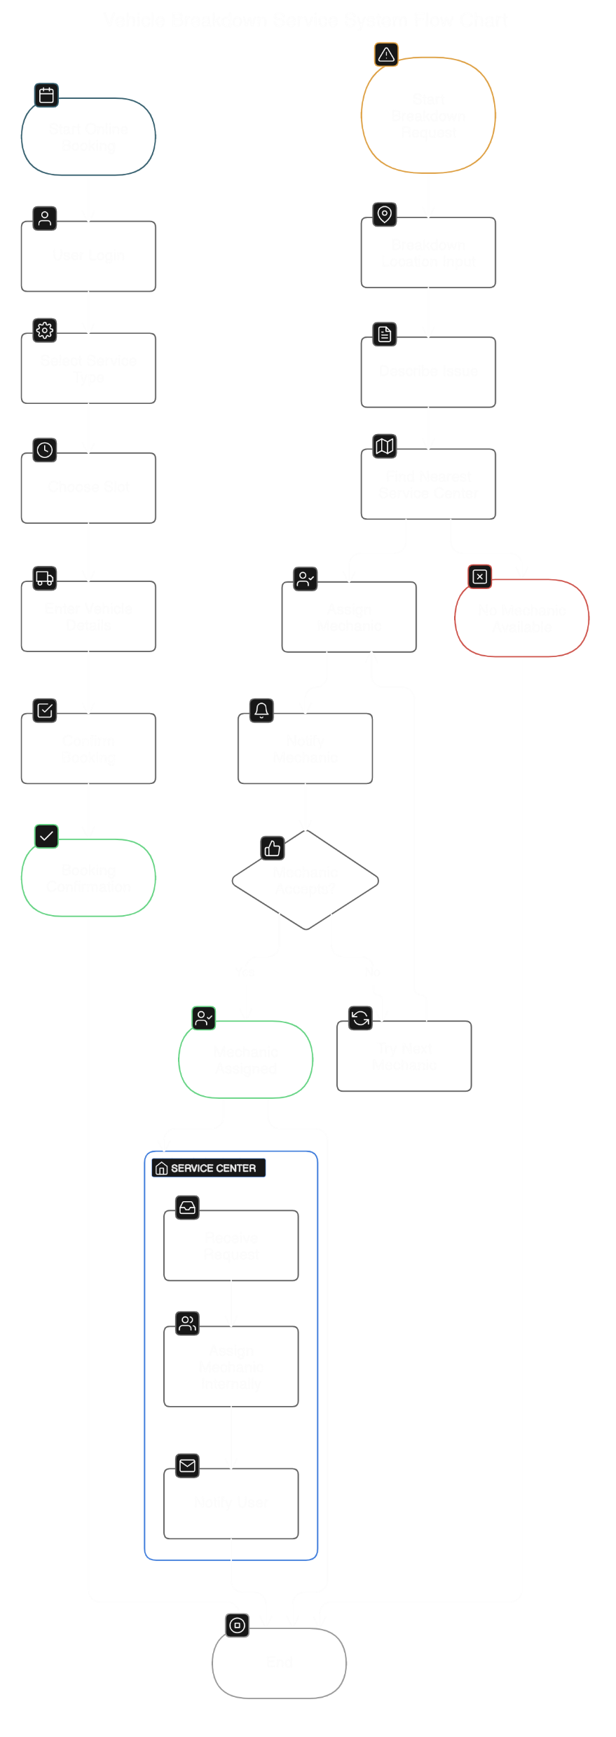

Slide 22


